Slide 1
Individualism & Collectivism

Slide 2
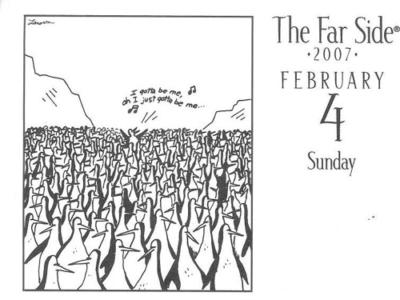
Individualism
The belief that the individual is the most important decision-making unit in a society.

Slide 3
Principles of Individualism
Rule of Law
Personal Freedoms
Private Property
Economic Freedom
Self-interest
Competition
Equality of Opportunity

Slide 4
Rule of Law
The law is the highest authority in the land
No one is above the law
Guarantees individual equality
Back

Slide 5
Personal Freedoms
Freedom of speech
Freedom of the press
Freedom of association
Freedom of religion
Other?
Back

Slide 6
Private Property
All property
Right to use and dispose of personal property as one wishes
Back

Slide 7
Economic Freedom
The right to make your own economic decisions
Dispose of and earn your income as you see fit
Linked to private property
Limited government regulation
Assumes reason governs individuals’ decisions
Back

Slide 8
Self-Interest
Looking out for number 1
If everyone looks after themselves the general good will benefit
Not purely selfish – do nothing that harms the group
Back

Slide 9
Competition
Competition results in the most efficient/best result
Economic, political, social
Competition between individuals
Assumes equality of opportunity
Back

Slide 10
Equality of opportunity
Everyone is born equal
Based on your skill, luck etc you progress from there
Idealized
Ignores endemic social, political, economic inequalities

Slide 11
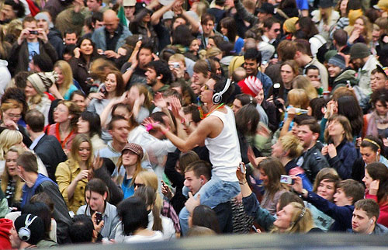
Collectivism
The belief that the group is the most important decision-making unit in a society

Slide 12
Principles of Collectivism
Economic equality
Co-operation
Public Property
Collective Interest
Collective Responsibility
Equality of Condition

Slide 13
Economic Equality
Can mean different things:
Equal access to the necessities of life (what are these?)
Minimum Wage
Common ownership
Redistribution of wealth/income
Government regulation
Back

Slide 14
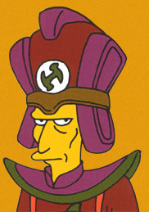
Co-operation
More can be accomplished when humans work together
Share work and proceeds
How are group decisions made?
Back

Slide 15
Public Property
Owned by government or group
Crown corporations
Proceeds/losses shared with public
Back

Slide 16
Collective Interest
Based on assumption that all humans share common interest whether they know it or not
The environment would be an example
Can be divided into various groups wirth common interests – labour unions, interest groups
Back

Slide 17
Collective Responsibility
Group bears responsibility for the actions/welfare of individuals – good and bad
Welfare, charity, drunk driving
Public awareness
Back

Slide 18
Equality of Condition
The group should work to ensure human equality is maintained throughout the life of the individual
Requires adherence to group norms

